Slide 1
Zuzka, Alexandra, Kristian, Nikola , Nina, Diana, Simonko
ŽILINA
The city where dreams come true.

Slide 2
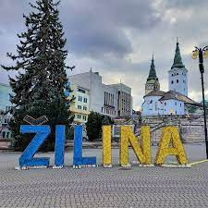
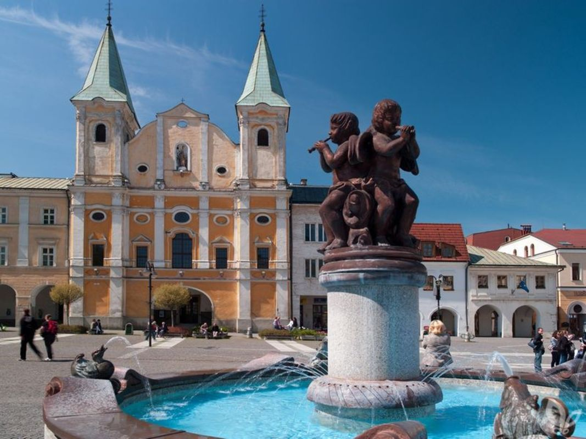
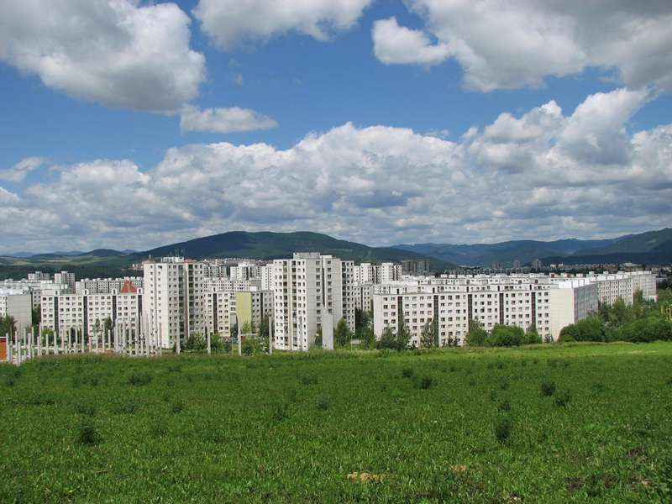
CONTENT
Location
Sport
General info
Famous people
Culture
Education

Slide 3
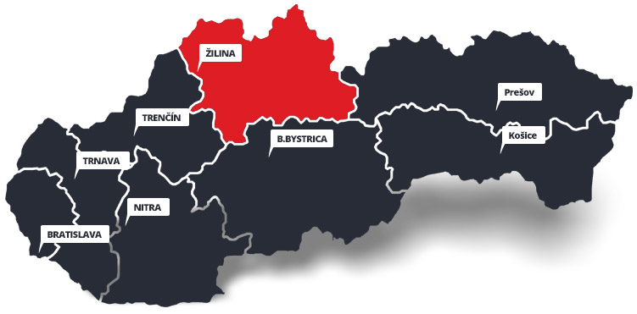
LOCATION

Slide 4
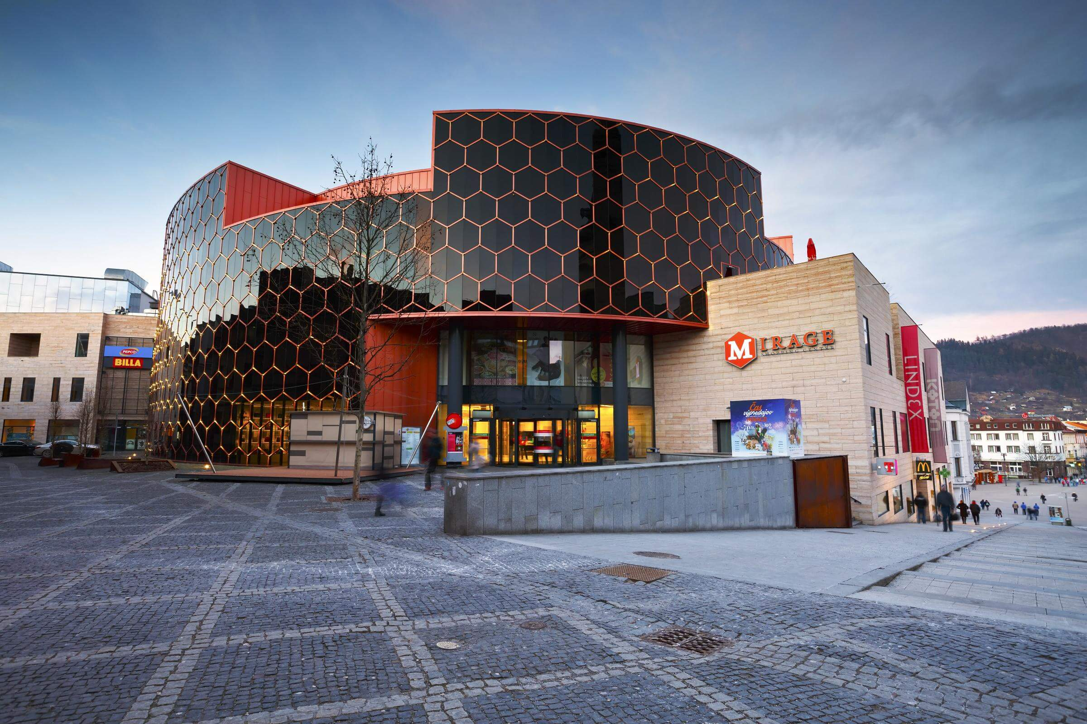
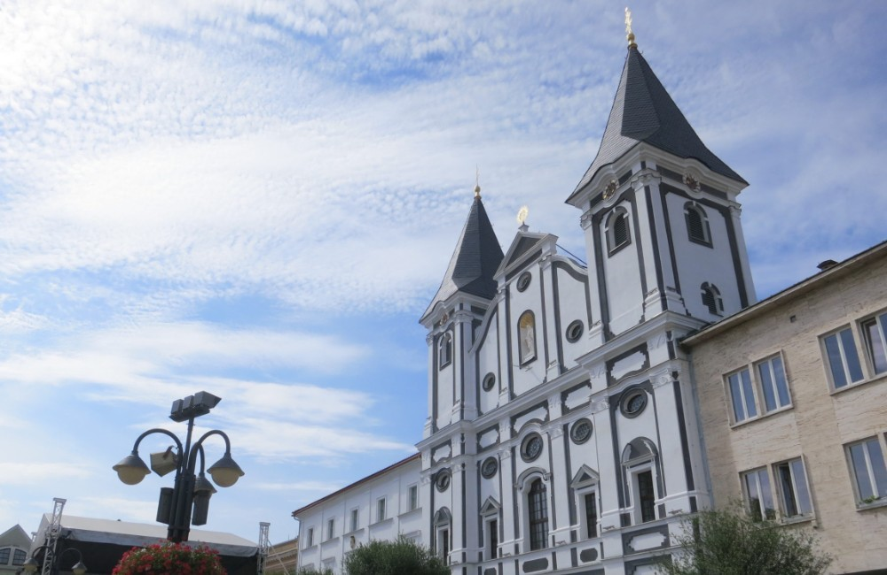
GENERAL INFO
80km2
82656 people
Historically based city
2 big malls
2 large squares

Slide 5
Hlinkovo square

Slide 6
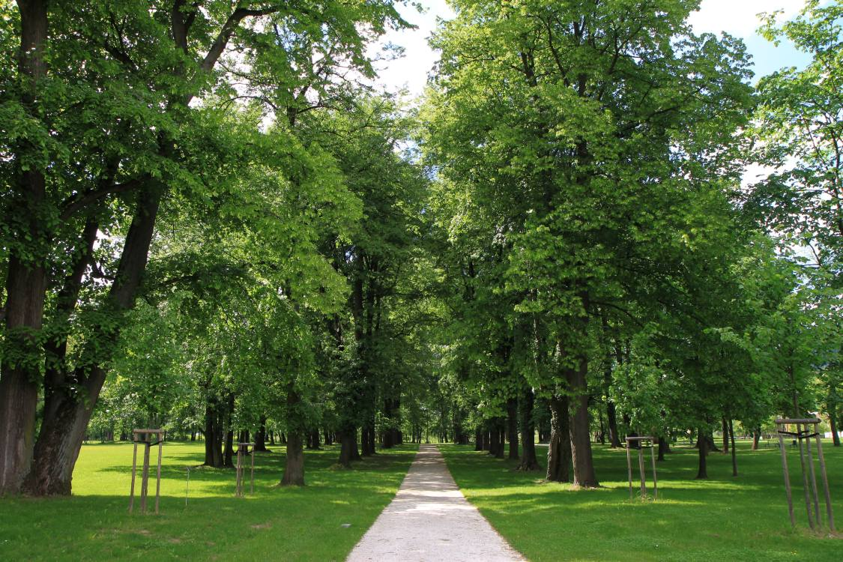
Budatin castle

Slide 7
CULTURE
Old town celebrations
They sell overpriced homemade food, toys and home equipment here.

Slide 8
CULTURE
Christmas market
Very similar to old town celebration but in winter.

Slide 9
CULTURE
Old town celebrations
There are concerts with slovak singers and overpriced delicious food.

Slide 10
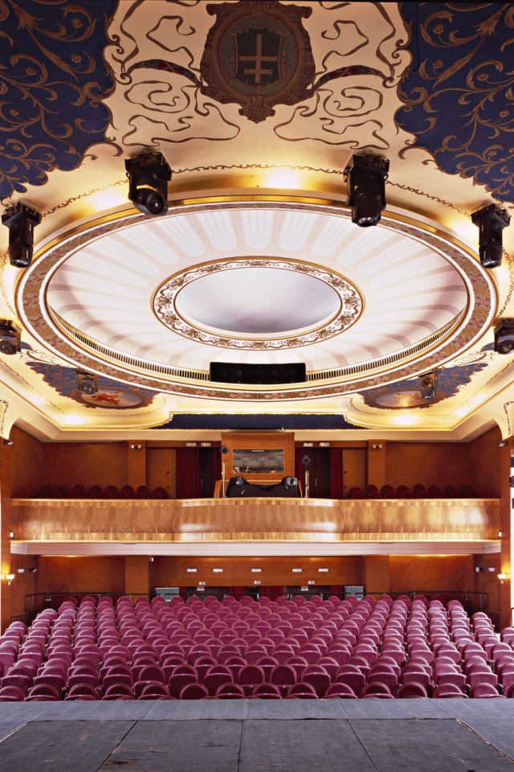
CULTURE
Theatre

Slide 11
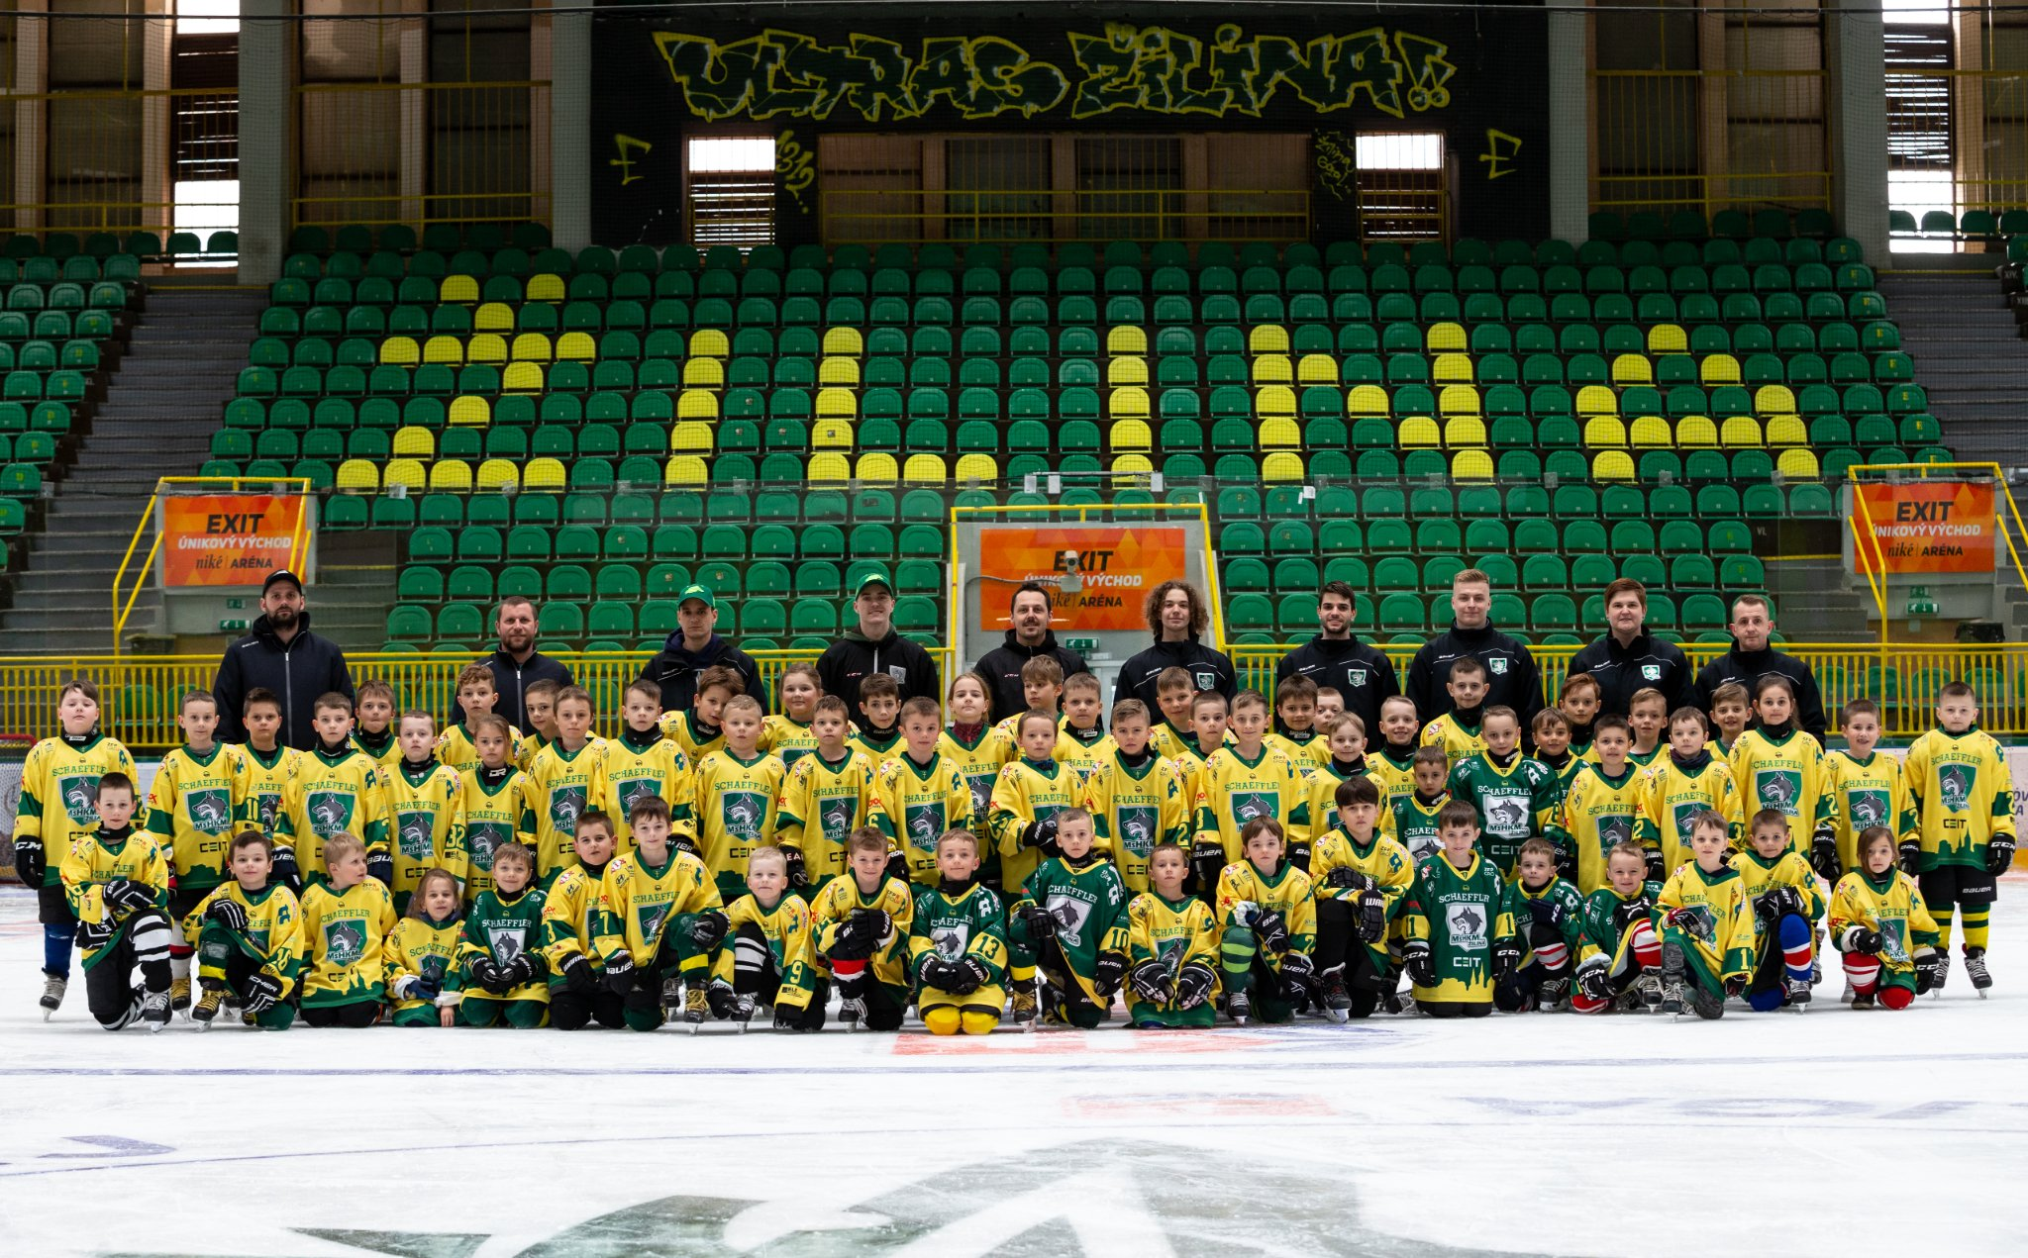
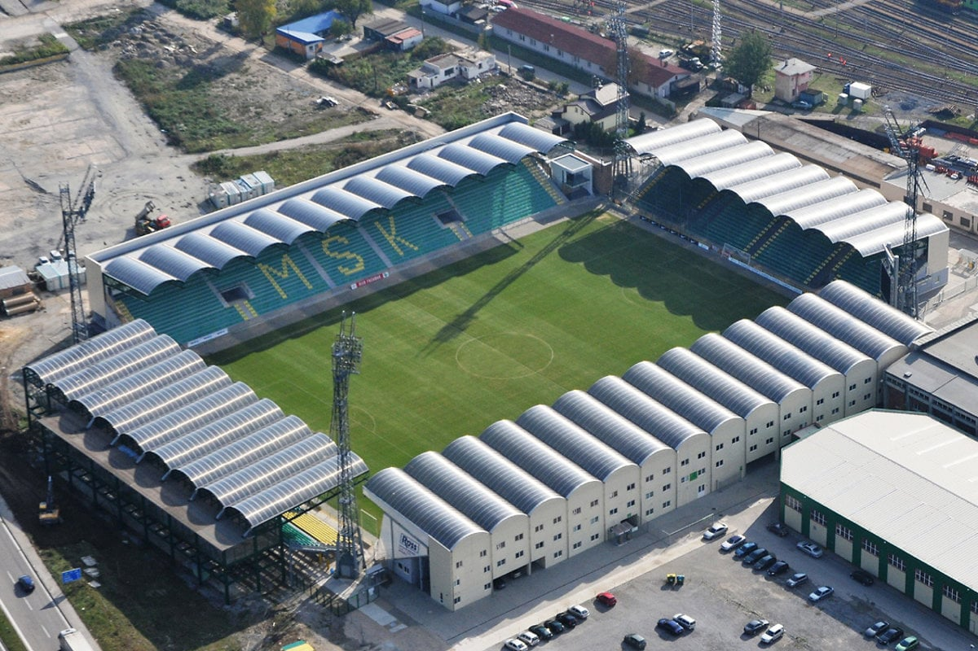
SPORT
Hockey team
Football stadion
Football team
Hockey stadion
Hockey stadion

Slide 12
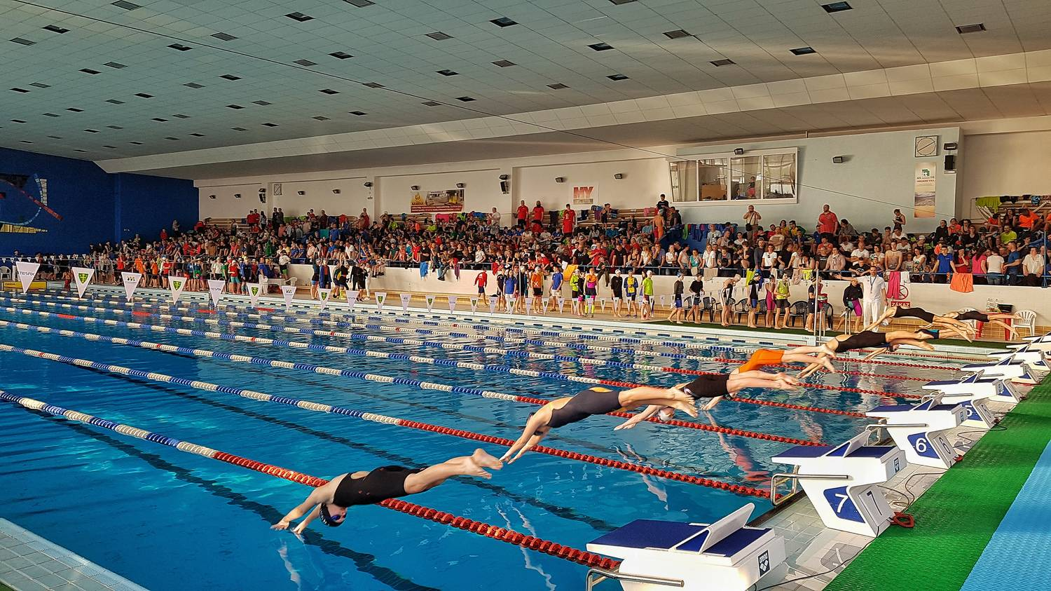
Swimming pool
Swimming clubs:
Nereus
Platesa
SPORT

Slide 13
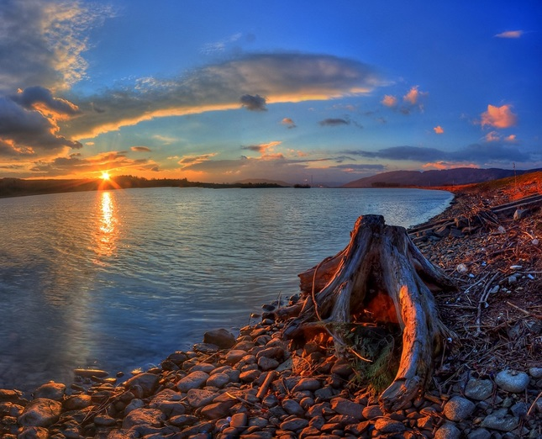
SPORT
Water dam you can do a lot of activites.

Slide 14
FAMOUS PEOPLE
Peter Sagan
Slovak cyclist
Accomplishments:
Green shirt tour de france 2012-2016,2018,2019

Slide 15
FAMOUS PEOPLE
Martin Dúbravka
Soccer player
In the year 2012 he qualified for the euro

Slide 16
EDUCATION
Business school (our school)

Slide 17
EDUCATION
Right across our school
Builder school

Slide 18
EDUCATION
University of Zilina

Slide 19
THANK YOU FOR YOUR ATTENTION

